Slide 1
Symmetric and Asymmetric Encryption
Locks and Keys: The Dual Guardians of Digital Secrets

Slide 2
Introduction to Cryptography
Cryptography: The science of transforming information to protect its confidentiality, integrity, and authenticity.
Used throughout history to secure communications and data.
Plays a vital role in our digital world, protecting everything from online transactions to sensitive personal information.

Slide 3
Cryptography Through the Ages
Early methods: Simple substitution ciphers (e.g., Caesar cipher)
World War II: Enigma machine and the birth of codebreaking.
Cold War Era: Advancements in cryptography fueled by information security needs
The Digital Age: Explosion of cryptographic applications to secure the internet.

Slide 4
The Pillars of Digital Security (CIA)
Confidentiality: Only authorized people can see the data.
Symmetric encryption scrambles data, making it unreadable without the correct key.
Key exchange protocols like Diffie-Hellman help establish shared keys securely for use with symmetric encryption.
Integrity: Data has not been altered or tampered with.
Hashing creates a unique fingerprint of data, allowing detection of even small changes.
Authenticity: We can verify the sender's identity and the origin of the data. Asymmetric encryption uses pairs of keys (public and private) for digital signatures.

Slide 5
Introduction to Symmetric Encryption
Quick Overview
Symmetric Encryption in Simple Terms: It's like having a secret codebook where the same code is used to jumble up your message and then unscramble it for reading. Only those with the codebook (the key) can understand the message.
Real-World Analogy
The Single-Key Safe: Imagine a sturdy safe that requires a specific key to both lock and unlock it. This represents the simplicity of symmetric encryption – one key controls both securing and accessing the information inside.

Slide 6
Introduction to Symmetric Encryption
Why This Matters
Speed: This single-key approach makes symmetric encryption very fast, perfect for situations where you need to protect lots of data quickly.
Use Cases: Think of encrypting all the files on your computer's hard drive, or quickly securing messages going back and forth within a trusted network.

Slide 7
Key Characteristics of Symmetric Encryption
Speed is King: Symmetric encryption algorithms are incredibly fast and efficient compared to asymmetric counterparts. This makes them the workhorse for encrypting large amounts of data quickly.

Slide 8
Where Symmetric Encryption Excels
Data at Rest: Encrypting entire hard drives or databases. Your files remain scrambled until the correct key unlocks them.
Data in Motion Within Secure Networks: Protecting data flying between servers inside a company's well-controlled network. This adds a layer of security even if internal traffic is intercepted.
Building Block for Hybrid Systems: Smaller pieces of information, especially symmetric keys themselves, are often initially shared using asymmetric encryption, leading to symmetric encryption for the bulk data. (More on this in a few slides)

Slide 9
Challenges of Key Management
The Key Distribution Conundrum: In symmetric encryption, everyone who needs to read the data must have the same key. Securely getting this key to all the right people without it falling into the wrong hands is a major challenge.
Safeguarding Keys: Keys need to be stored securely. If they're lost or compromised, the encrypted data is as good as gone. Keys also have a lifespan – they need to be regularly changed (rotated) to reduce the risk of compromise.

Slide 10
Alice & Bob's Secret Message
Alice wants to send Bob an encrypted message. How do they share the key?
Sending the key in plain text alongside the message defeats the purpose!
Potential Solutions:
Pre-shared keys (they meet beforehand, in secret)
Trusted third party to facilitate distribution
Key exchange protocols like Diffie-Hellman (we’ll talk in depth about this soon!)

Slide 11
Best Practices in Key Management
Secure Key Exchange: The Foundation
Methods like Diffie-Hellman allow parties to agree on a shared secret key over a public channel without ever directly sending the key itself.
Key Storage: Protection is Paramount
Hardware Security Modules (HSMs): Specialized, tamper-resistant devices that store and manage keys, offering a high level of protection.
Encrypted Key Vaults: Software-based solutions that securely store keys, protected with strong encryption themselves.

Slide 12
Best Practices in Key Management
Key Rotation: A Healthy Habit
Regularly change keys to minimize the impact if one is compromised. The more sensitive the data, the more frequent the rotation.
Access Control: Need-to-Know Only
Strict policies for who can access keys, using principles like least privilege. The fewer people with access, the lower the risk.

Slide 13
Introduction to Asymmetric Encryption
Definition: A system where two mathematically linked keys are used:
Public Key: Freely shared, used for encryption.
Private Key: Kept secret, used only for decryption.

Slide 14
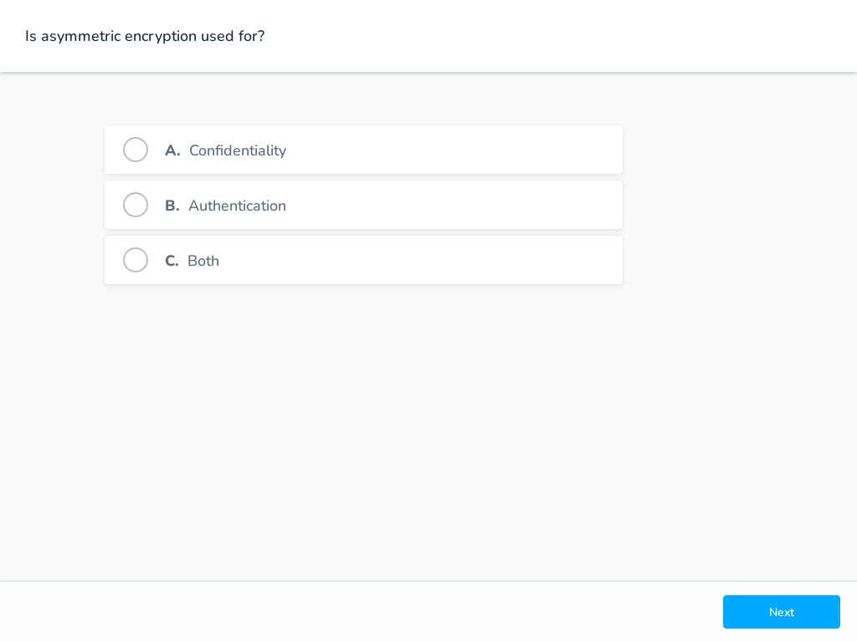


Slide 15
Key Management
Distribution Made Easy: Public keys are meant to be shared – they can be posted on websites, included in email signatures, etc.
The Private Key is Sacred: It MUST be protected. If compromised, all past and future messages encrypted with the corresponding public key are potentially readable.

Slide 16
Use Cases: Digital Signatures
Alice signs a document with her private key. Anyone can verify with her public key.
Proves authenticity (only Alice could have signed it) and integrity (content hasn't changed).
Remember you verified the Mozilla installer last semester with GPG

Slide 17
Use Cases: Secure Email (GPG or PGP)
Alice encrypts the email with Bob's public key
Only Bob's private key can decrypt.
Last semester you encrypted your partner’s signed key with their public key using GPG.

Slide 18
SSL/TLS (HTTPS Websites)
Your browser gets the website's public key, verifies its authenticity,
Where do they then they agree on a symmetric key for fast communication??

Slide 19
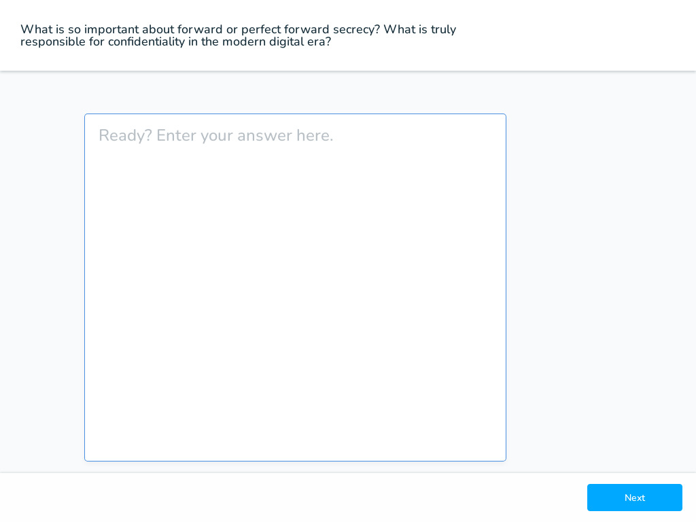


Slide 20
Diffie-Hellman Key Exchange
Key Exchange Protocol: Diffie-Hellman (DH) enables two parties to establish a shared secret over an unsecured communication channel. This shared secret can then be used to encrypt subsequent communications using symmetric key cryptography.
Asymmetric Principles: It utilizes asymmetric principles, where each party generates public and private keys. The magic of DH lies in its ability for two parties to end up with a shared secret that only they know, despite exchanging information over a public channel where interceptors can see their exchanged data.

Slide 21
Diffie-Hellman Key Exchange
Not Encryption: Unlike RSA or ECC, which are used for both key exchange and encryption/decryption, DH is solely for key exchange. The shared secret generated by DH is typically used as the key in a symmetric encryption algorithm to encrypt and decrypt messages.
Foundation for Secure Communications: DH is fundamental to many protocols that secure communications over the internet, including HTTPS, SSH, and IPSec, providing a secure method of exchanging the keys needed for symmetric encryption.

Slide 22
Asymmetric: RSA
Rivest–Shamir–Adleman:
One of the earliest and most widely used asymmetric algorithms.
Based on the difficulty of factoring large prime numbers.
Strengths: Proven track record, widely implemented and trusted.
Weakness: Susceptible to future attacks by quantum computers. Requires relatively large key sizes for adequate security.

Slide 23
Asymmetric: ECC
Elliptic Curve Cryptography:
More recent, based on the mathematics of elliptic curves over finite fields.
Key Advantage: Offers the same level of security as RSA with significantly smaller key sizes.
Benefits: Faster, requires less computing power and storage space– ideal for mobile devices and resource-constrained environments.
Growing Adoption: Increasingly used in modern security systems, especially where resources are limited.

Slide 24
Computational Difficulty and Quantum Computing
Quantum Computers: These theoretical machines can solve certain types of problems much faster than classical computers. Specifically, they could potentially break current encryption algorithms by efficiently solving the mathematical problems (like factoring large numbers for RSA or solving discrete logarithm problems for ECC) on which their security is based.
Stable Qubits: Quantum computers operate using qubits, which can represent and store information in a way that allows for more complex computation than traditional bits. The number of stable qubits a quantum computer has is crucial for its computational power. Current quantum computers have a limited number of qubits that are stable enough to perform calculations, which restricts their ability to break encryption.

Slide 25
Computational Difficulty and Quantum Computing
Key Size and Computational Effort: The effort required to break encryption scales with the size of the encryption key. Quantum computers are expected to break smaller keys more easily than larger ones. However, the algorithms most at risk from quantum attacks (RSA, ECC) don't scale in difficulty as linearly with key size in the quantum context as they do in classical cryptography. ECC, for instance, provides stronger security per bit of key length compared to RSA, meaning ECC can use smaller keys to provide equivalent security against classical attacks. This characteristic potentially makes ECC harder to break with early quantum computers, which will have limited qubit stability and computational capacity.

Slide 26
Practical Implications for ECC
Storage and Bandwidth: Smaller keys are beneficial because they require less storage space and bandwidth. This is particularly important for devices with limited storage or processing power and in situations where large volumes of data need to be encrypted and transmitted efficiently.
Performance: Cryptographic operations with smaller keys are faster, improving overall system performance. This is crucial for real-time applications or devices with limited computational resources.

Slide 27
Agility Against Future Threats
Migration to Quantum-resistant Algorithms: The field of post-quantum cryptography is developing algorithms that are resistant to quantum computing attacks. Systems using ECC, because of their smaller key sizes and less intensive computational requirements, might find it easier to migrate to new, quantum-resistant algorithms compared to systems heavily reliant on larger-key RSA encryption. This potential for easier migration makes ECC an attractive option as we prepare for the advent of practical quantum computing.
Re-encryption and System Redesign: In a future where quantum computers can break current encryption, systems will need to re-encrypt sensitive data with quantum-resistant algorithms. Smaller keys and the systems designed around them could be more adaptable, requiring less overhaul of existing infrastructure to accommodate the new security measures.

Slide 28
Practical Limitations of Asymmetric Encryption
Computational Intensity: Asymmetric encryption algorithms are significantly more resource-intensive than their symmetric counterparts. Encrypting large files directly would be time-consuming and place a heavy load on systems.

Slide 29
Practical Limitations of Asymmetric Encryption
Payload Size Limitation: The maximum amount of data directly encryptable with asymmetric encryption is tied to the key size. For instance, with a 2048-bit RSA key, you can encrypt a bit less than 256 bytes, with some space needed for essential security padding.

Slide 30
Practical Limitations of Asymmetric Encryption
Hybrid Approach is Best: Asymmetric encryption shines in secure key exchange and encrypting small messages. This allows us to securely distribute a symmetric key, which then handles the efficient encryption of large amounts of data.

